Slide 1
ESS 23 Lab Solutions 3

Slide 2
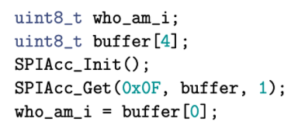

Slide 3
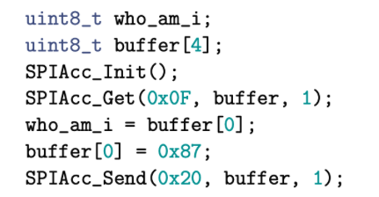

Slide 4
